Slide 1
Deep Learning(NLP)

Slide 2
Broad Outline of what we plan to cover
Week 1 :
Demo of our AIA Free text classifier
Text Classification in General
Deep Learning concepts
Word Vectors
Week 2 :
Name Entity Recognition
Recurrent Neural Networks (RNN’s)
Long Short Term Memory Networks (LSTMS)
Week 3
Learn about Attention
Transformers
Retrieval
Bert(Bidirectional Encoder Representations From Transformers)
Would pick an example to show how this functions.
Week 4
Subword Segmentation
Siamese Networks
GPT: Generative Pre Training

Slide 3
AIA Free Text Classifier

Slide 4
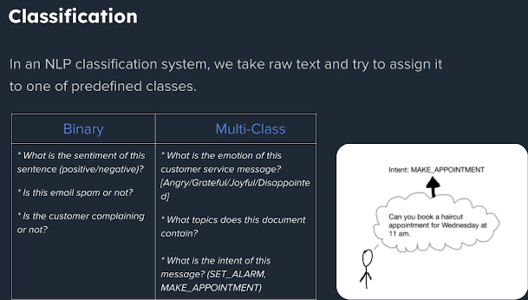
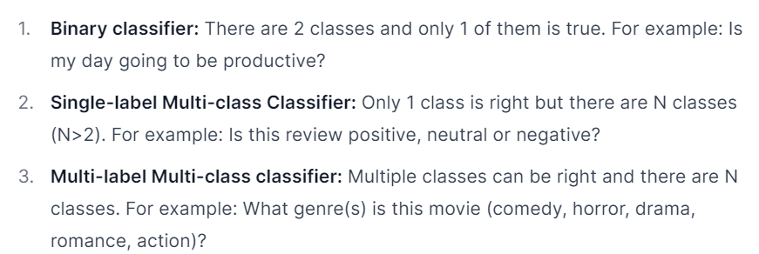
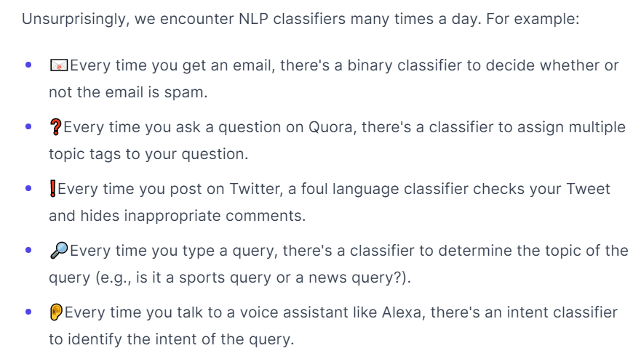
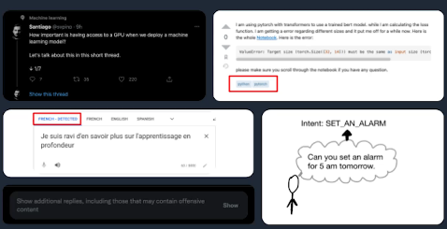
Text Classification in General

Slide 5
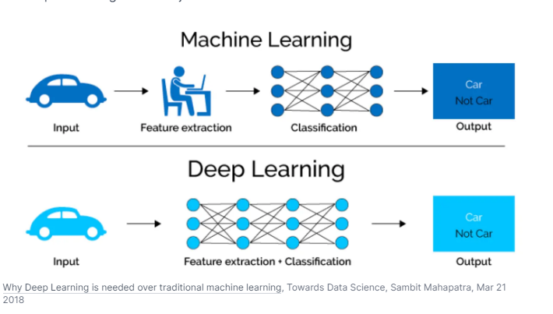
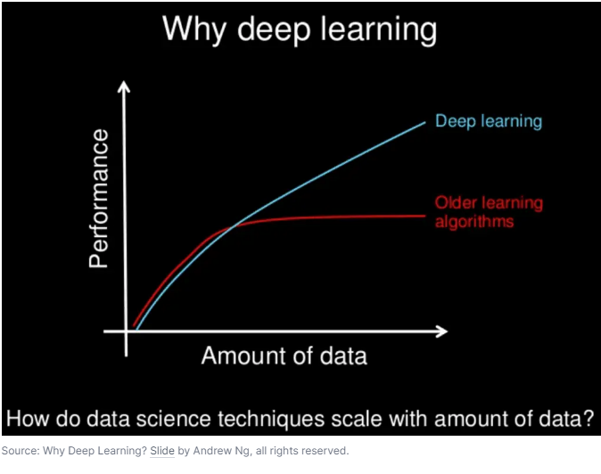
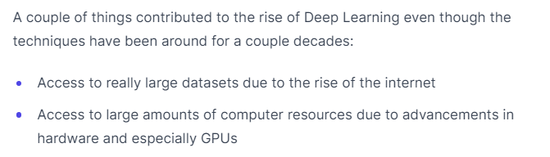
Deep Learning in General

Slide 6
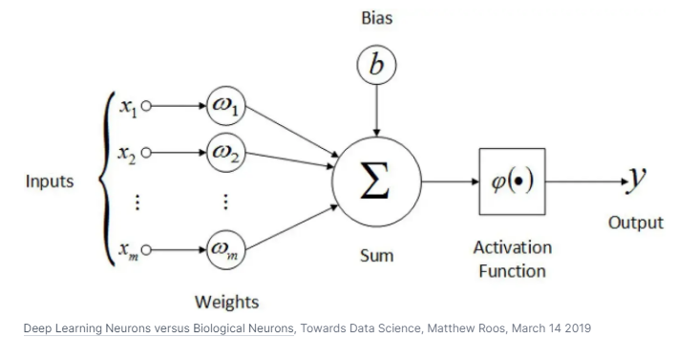
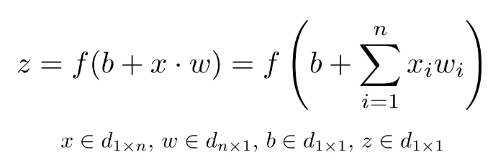
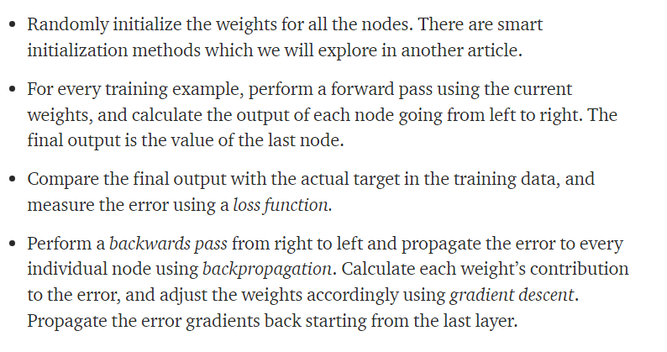
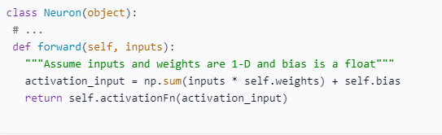
Parts of a Neural Network?

Slide 7
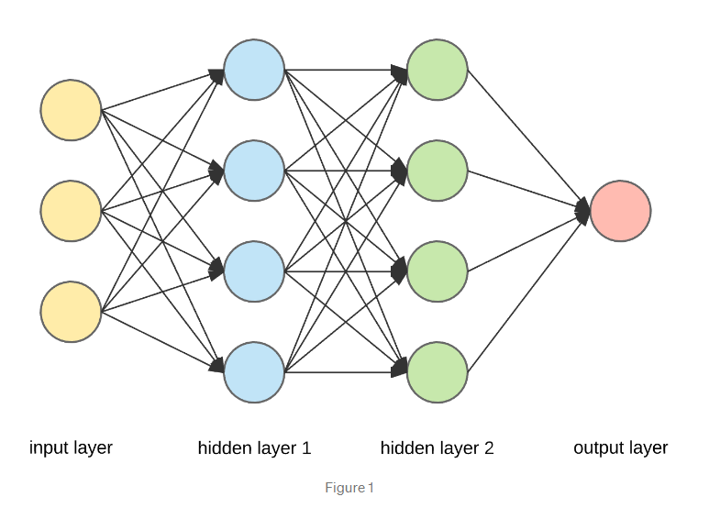
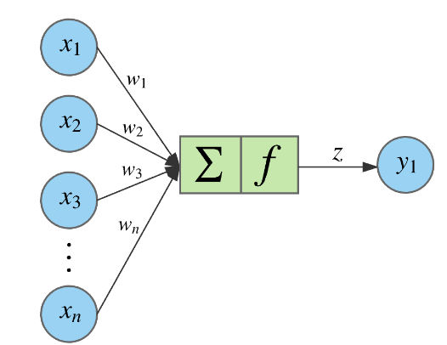
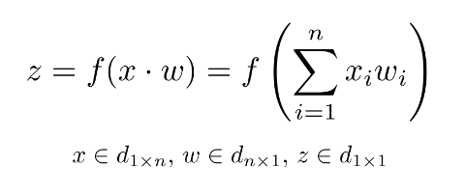
Intuition of what is happening here
Essentially what each layer of the ANN does is a non-linear transformation of the input from one vector space to another.
We have a 3-dimensional input corresponding to a vector in 3D space.
We then pass it through two hidden layers with 4 nodes each. And the final output is a 1D vector or a scalar.
If we zoom to one of the nodes above.

Slide 8
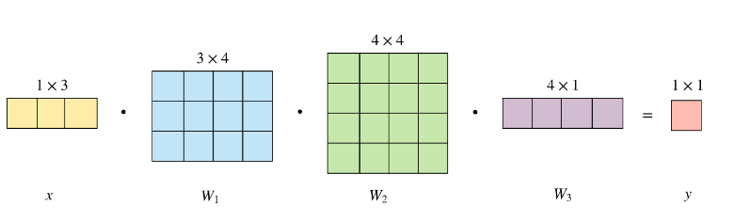
So if we visualize this as a sequence of vector transformations, we first map the 3D input to a 4D vector space, then we perform another transformation to a new 4D space, and the final transformation reduces it to 1D. This is just a chain of matrix multiplications. The forward pass performs these matrix dot products and applies the activation function element-wise to the result.
The input vector x has 1 row and 3 columns. To transform it into a 4D space, we need to multiply it with a 3x4 matrix. Then to another 4D space, we multiply with a 4x4 matrix. And finally to reduce it to a 1D space, we use a 4x1 matrix.
These matrices represent the weights that define the ANN. To make a prediction using the ANN on a given input, we only need to know these weights and the activation function (and the biases), nothing more. We train the ANN via backpropagation to “learn” these weights.

Slide 9
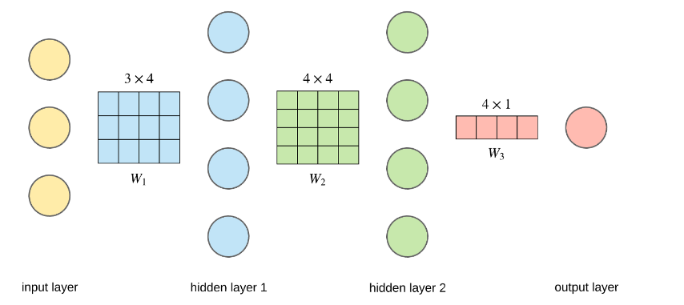
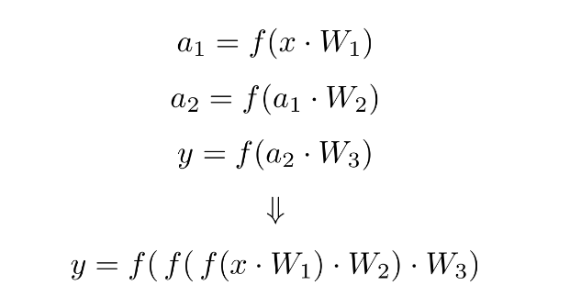
The output of the matrix multiplications go through the activation function f. In case of the sigmoid function, this means taking the sigmoid of each element in the matrix.

Slide 10
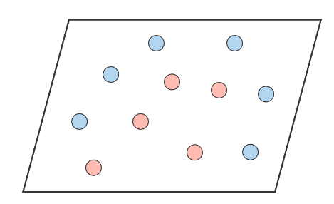
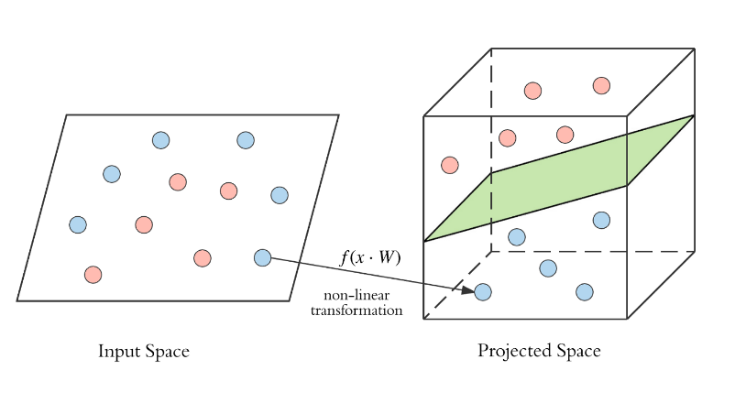
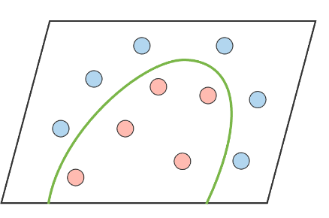
Why go deep in the first place
These data points are not linearly separable by using the normal machine learning algos except might be SVM’s using the Kernel trick
So we project it to a higher dimensional space by performing a non-linear transformation, and then it becomes linearly separable. The green hyperplane is the decision boundary.
This is equivalent to drawing a complex decision boundary in the original input space.
So the main benefit of having a deeper model is being able to do more non-linear transformations of the input and drawing a more complex decision boundary.
This is how non-linearity being expressed in neural networks can solve more complex problems compared to purely linear modes.

Slide 11
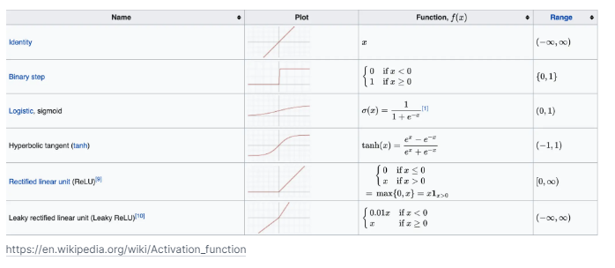
Activation Functions
Activation functions introduce non linearity in a network
Every activation function (or non-linearity) takes a single number and performs a certain fixed mathematical operation on it.
They are mainly used to scale the inputs to a certain output range.

Slide 12
Which Activation Function to use
Use the ReLU non-linearity, but be careful with your learning rates and possibly monitor the fraction of "dead" units in a network.
Try concepts like dropouts etc so introduce some randomness in your training.
If this hits you, give Leaky ReLU a try.
Never use sigmoid especially in the middle layers as this might give you exploding gradient or vanishing gradient problem.
Try tanh, but expect it to work worse than ReLU.
Try tensor flow playground to explore more on these activation functions
https://playground.tensorflow.org/

Slide 13
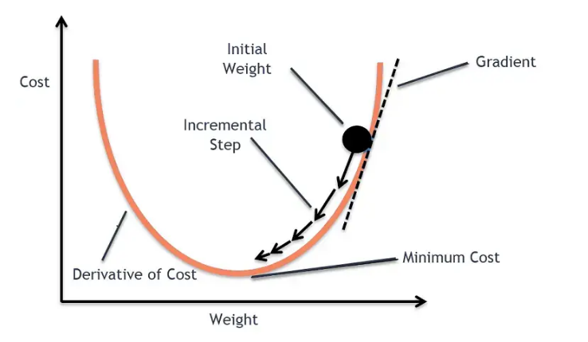
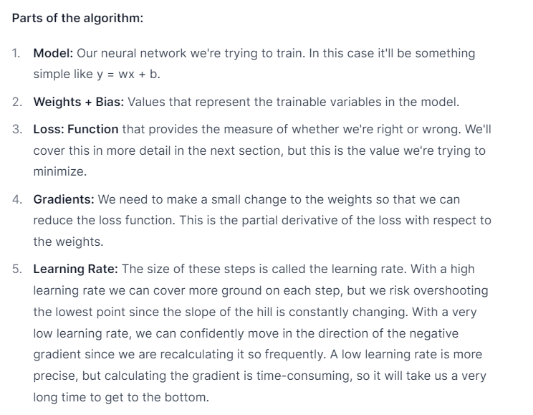
Gradient Descent
Gradient descent is an algorithm that numerically estimates where a function outputs its lowest values.
It might find a local minima in non-convex functions.

Slide 14
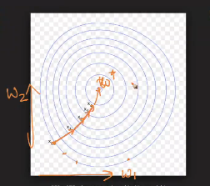
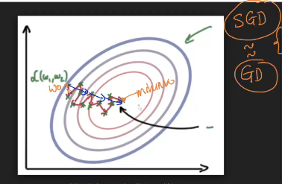
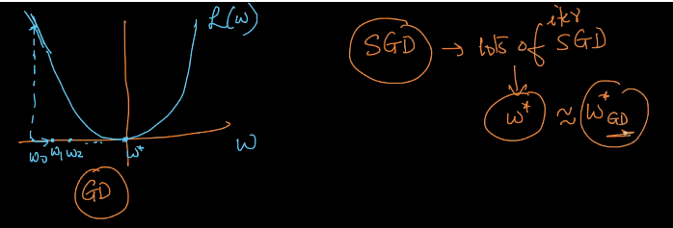
Mini batch Gradient Descent
In large-scale applications, the training data can have on order of millions of examples.
Hence, it seems wasteful to compute the full loss function over the entire training set in order to perform only a single parameter update.
A very common approach to address this challenge is to compute the gradient over batches of the training data.
A typical batch contains 256 examples from the entire training set, this batch is then used to perform a parameter update
Now the mini batch gradient descent is not the same as gradient descent. They are just approximations. So we take that leverage.

Slide 15
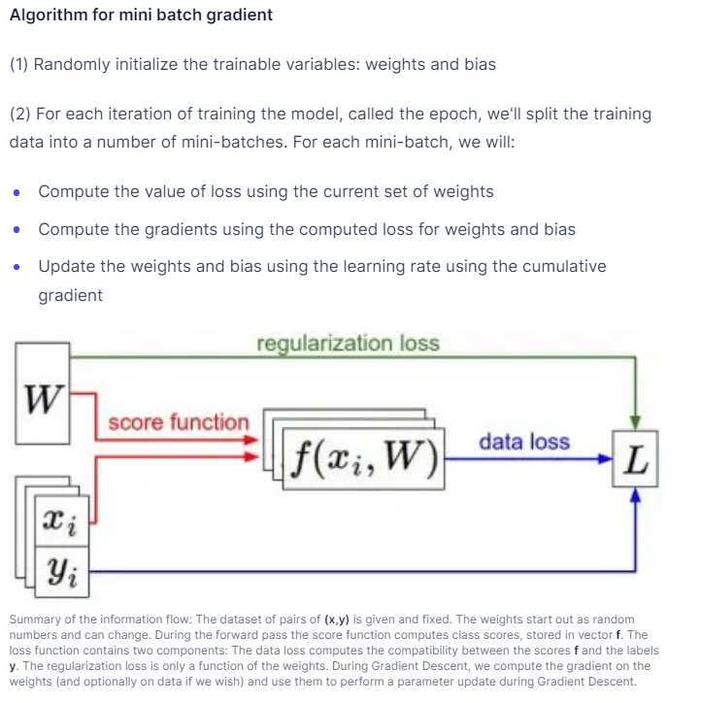

Slide 16
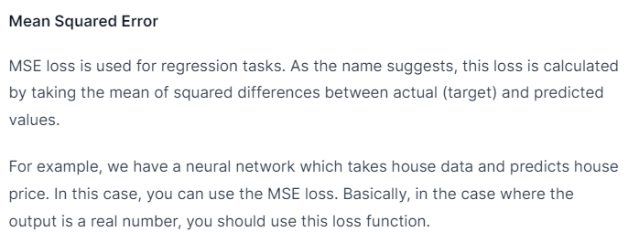
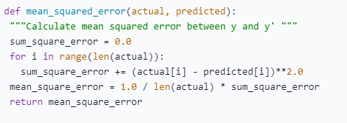
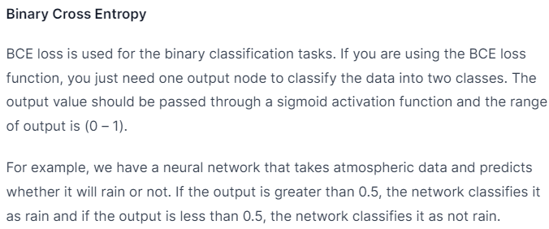
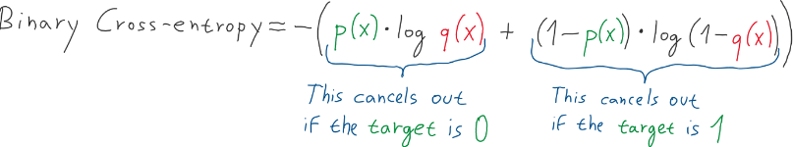
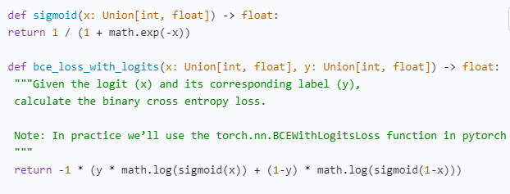
Loss Functions

Slide 17
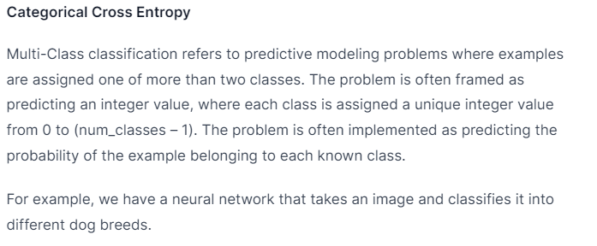
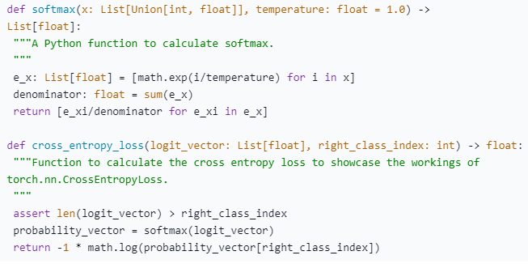

Slide 18
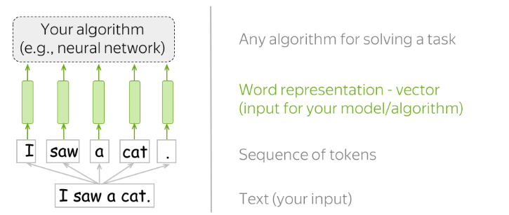
Word Vectors
The way machine learning models "see" data is different from how we (humans) do.
For example, we can easily understand the text "I saw a cat," but our models can not - they need vectors of features.
Such vectors, or word embeddings, are representations of words that can be fed into your model.
The first and the most important part of our nlp task is to represent a word as a vector such that our mathematical models can cosume.
Caveat : The word vectors should be done in a way that they have some sort of symantic resemblance.
So while converting a text to a number ensure that number carries some symatic meaning with respect to the word

Slide 19
Word embedding Techniques
Prediction Based
Word2Vec
Frequency Based
Bag of words
TF-IDF
Glove embedding
Matrix Factorization

Slide 20
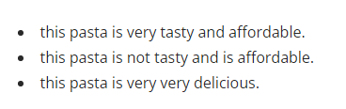
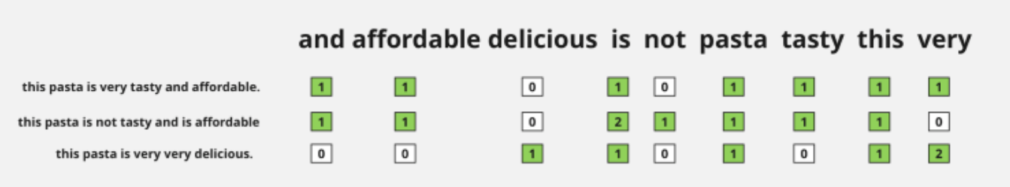
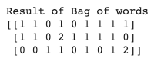
Bag of Words
Corpus
Issues like Sparsity, overfitting and out of vocabulary

Slide 21
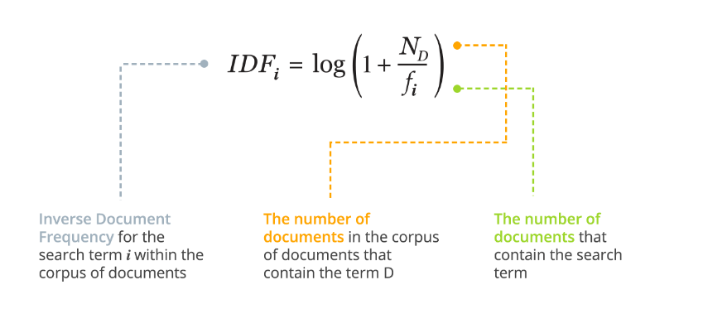
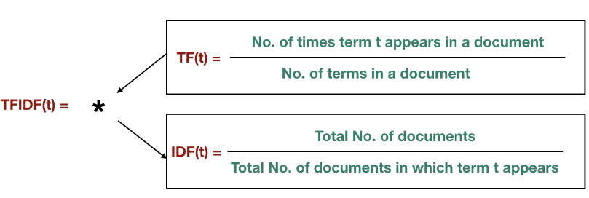
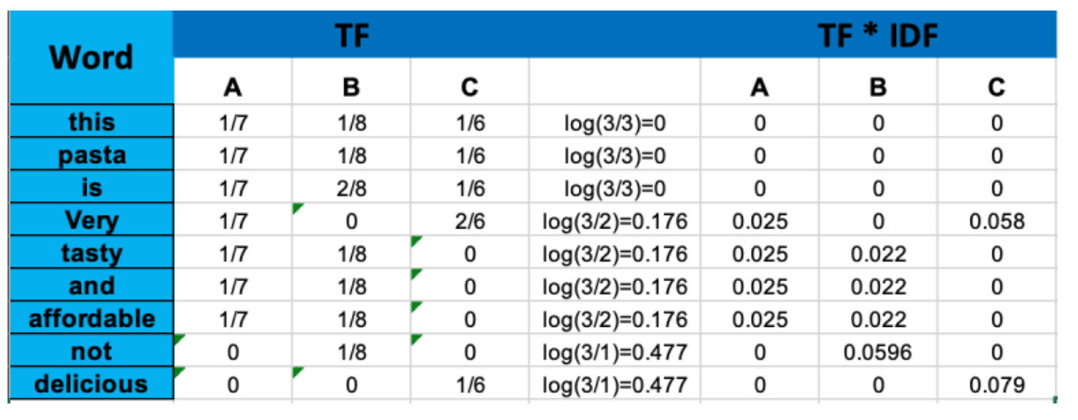
TF - IDF
We can observe rarer words have more score than common words.
That shows us the significance of the words in our corpus.

Slide 22
Word2Vec (Prediction Based)
Made by Google
Unlike the frequency based embeddings, this can give us semantic meanings like (happy and joy are similar)
BOW and TFIDF vectors are huge vectors mostly sparse vectors[10000]. Word2Vec vectors are
low dimension vectors like [100-300]
Vectors are dense vectors and not sparse in nature, thus low probability for overfitting.
This uses Deep learning to build.
The pretrained word2Vec model are 300- dimensional vectors are built on 3 billion words for
3 million words and phrases.

Slide 23
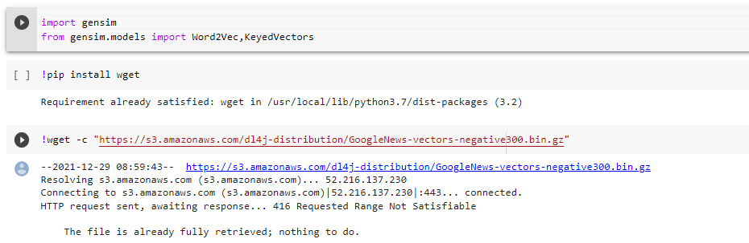
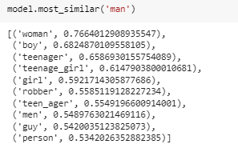
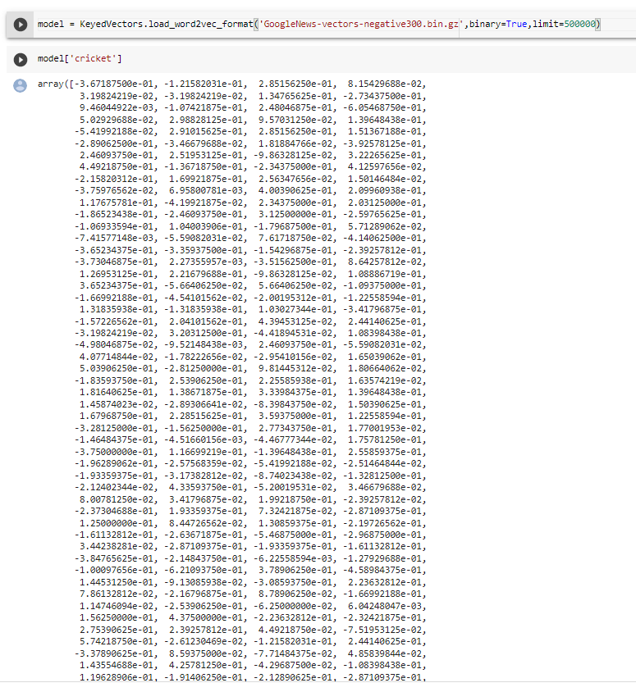
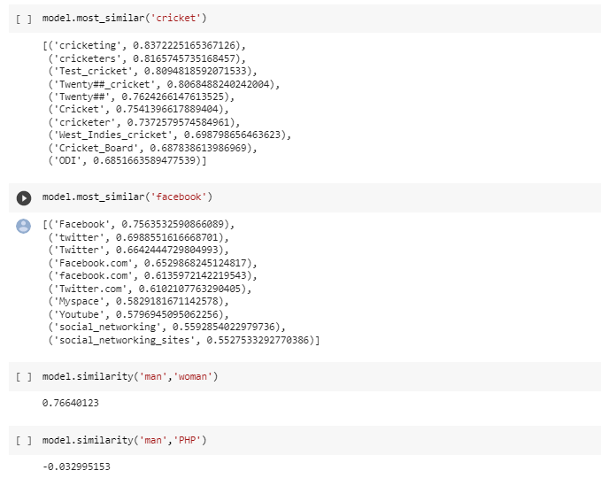

Slide 24
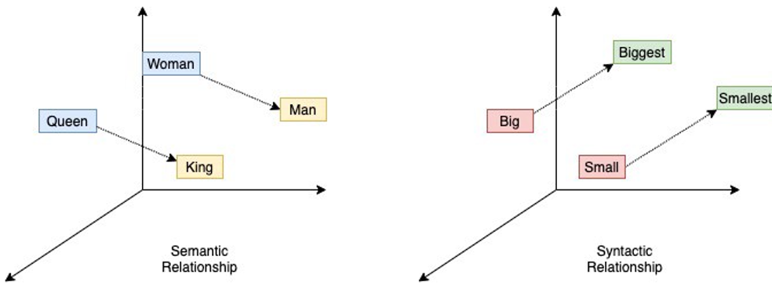
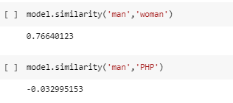
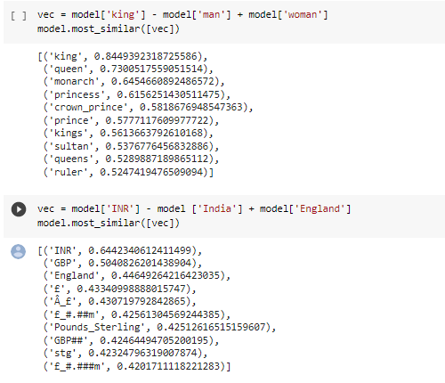
Symantic relationship between the word vectors
Since this is around 30 lakh words, this takes some time to calculate

Slide 25
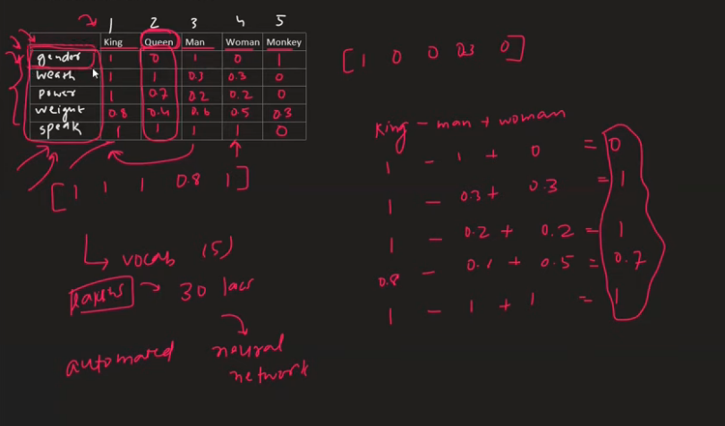
Intuition
For a small corpus of workds it is easier to create hand crafted features.
But for the English word corpus, we
might have so many features which
Cannot be handcrafted, thus Neural network to the rescue

Slide 26
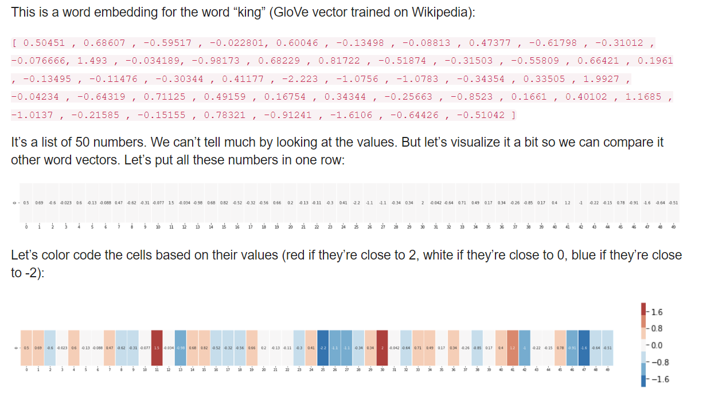

See how “Man” and “Woman” are much more similar to each other than either of them is to “king”? This tells you something. These vector representations capture quite a bit of the information/meaning/associations of these words.

Slide 27

A few things to point out:
There’s a straight red column through all of these different words. They’re similar along that dimension (and we don’t know what each dimensions codes for)
You can see how “woman” and “girl” are similar to each other in a lot of places. The same with “man” and “boy”
“boy” and “girl” also have places where they are similar to each other, but different from “woman” or “man”. Could these be coding for a vague conception of youth? possible.
All but the last word are words representing people. I added an object (water) to show the differences between categories. You can, for example, see that blue column going all the way down and stopping before the embedding for “water”.
There are clear places where “king” and “queen” are similar to each other and distinct from all the others. Could these be coding for a vague concept of royalty?
The underlying assumption of Word2Cev is that two words sharing similar contexts also share a similar meaning and consequently a similar vector representation from the model.

Slide 28



Slide 29

Skip Gram

Slide 30



Architecture - CBOW
Predict focus words given context words.

Slide 31

Architecture N Gram
Cbow is faster to train than Skipgram
Cbow tends to work better for frequently occurring
words as we would have more context around these
words.
Can work with smaller data sets.
Good for infrequent words
For both Skipgram and Cbow as we increase the number of context words, the feature set of each data point is richer
If we increase the number of the neurons in the middle layer, the feature set would be richer and more representative
https://aegis4048.github.io/demystifying_neural_network_in_skip_gram_language_modeling

Slide 32



Data set anatomy

Slide 33

Single Neuron

Slide 34


Fully connected Neural network

Slide 35

Activation Functions
Without Activation functions our Neural network becomes a linear function

Slide 36


Loss Functions

Slide 37

Model Training

Slide 38


Back Propogation

Slide 39


